Slide 1
Analysis of Gene Expression Data
Taryn Harradine

Slide 2
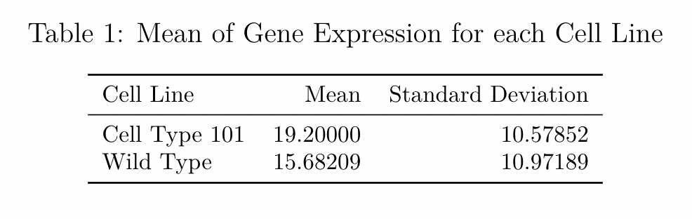
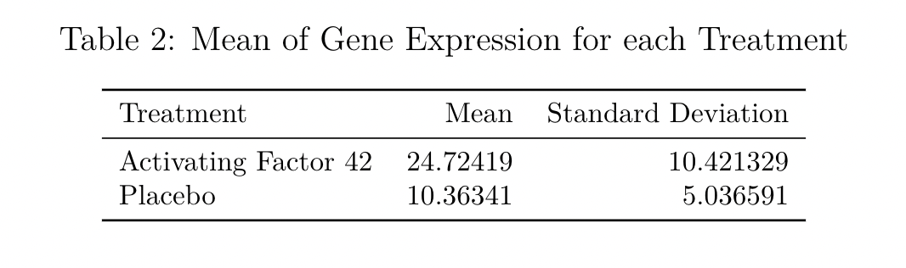
Mean and Standard Deviation of Gene Expression

Slide 3
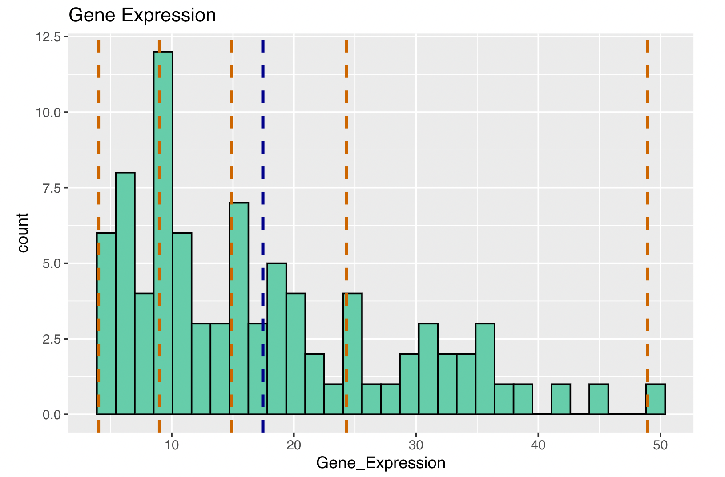
Distribution of Gene Expression
Q1
Minimum
Median
Mean
Maximum
Q3

Slide 4
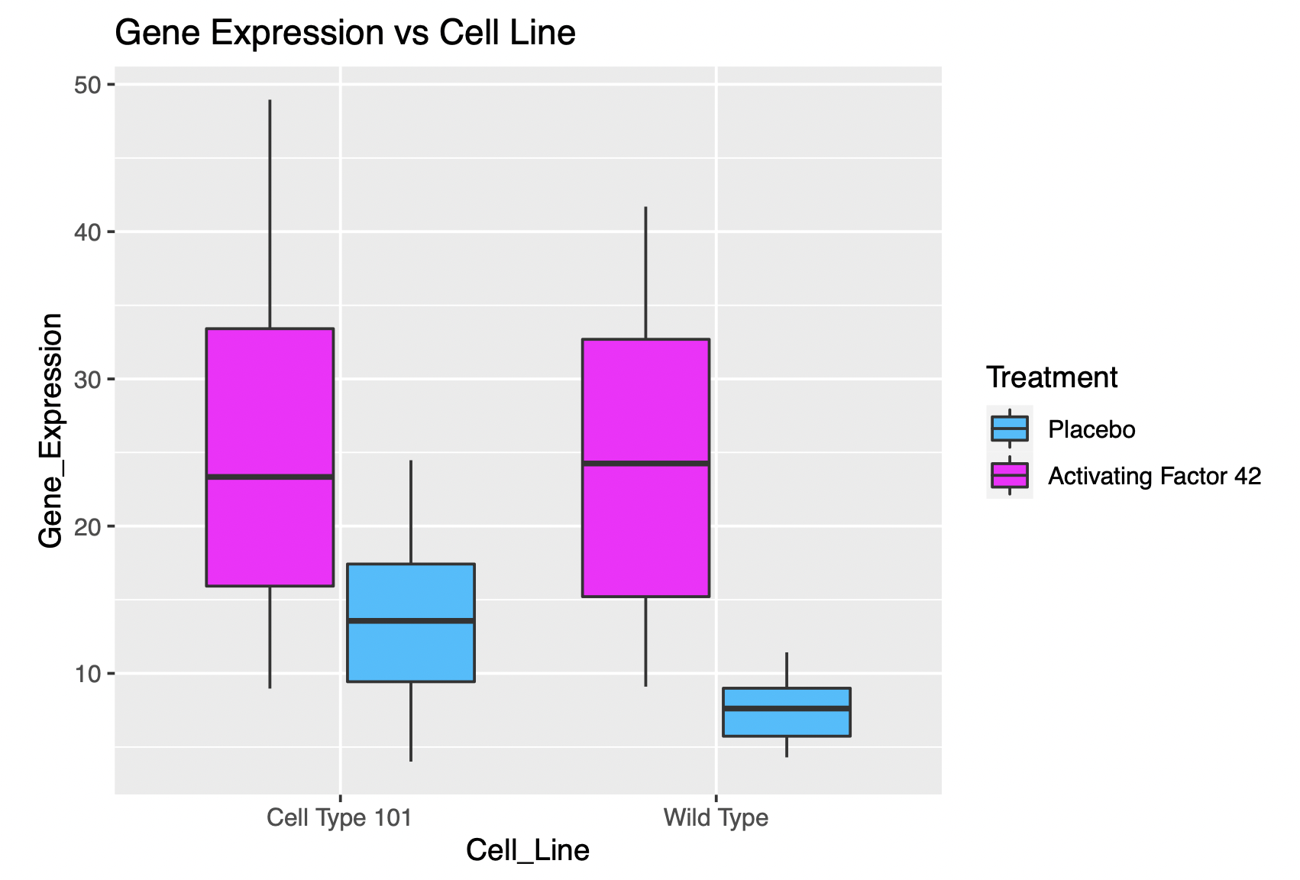
Boxplot of Cell Line vs Gene Expression {coloured by Treatment}
48.96
41.70
33.96
32.69
23.34
24.47
24.25
15.47
17.65
13.57
15.21
11.43
9.28
9.02
8.97
9.10
7.62
5.71
4.01
4.30
4.01

Slide 5
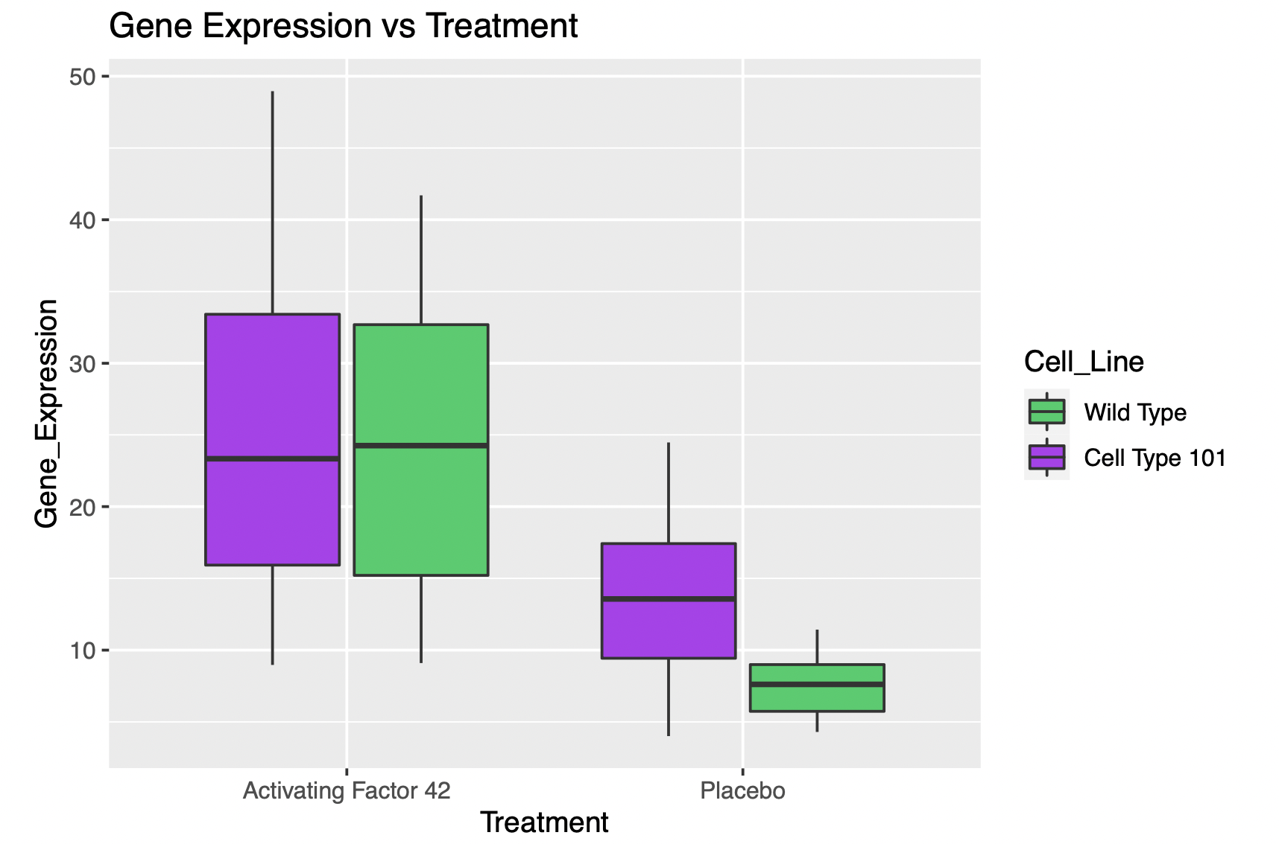
Boxplot of Treatment vs Gene Expression {coloured by Cell Line}
48.96
41.70
33.96
32.69
23.34
24.25
24.47
15.47
17.65
15.21
13.57
9.28
11.43
9.10
9.02
8.97
7.62
5.71
4.01
4.30

Slide 6
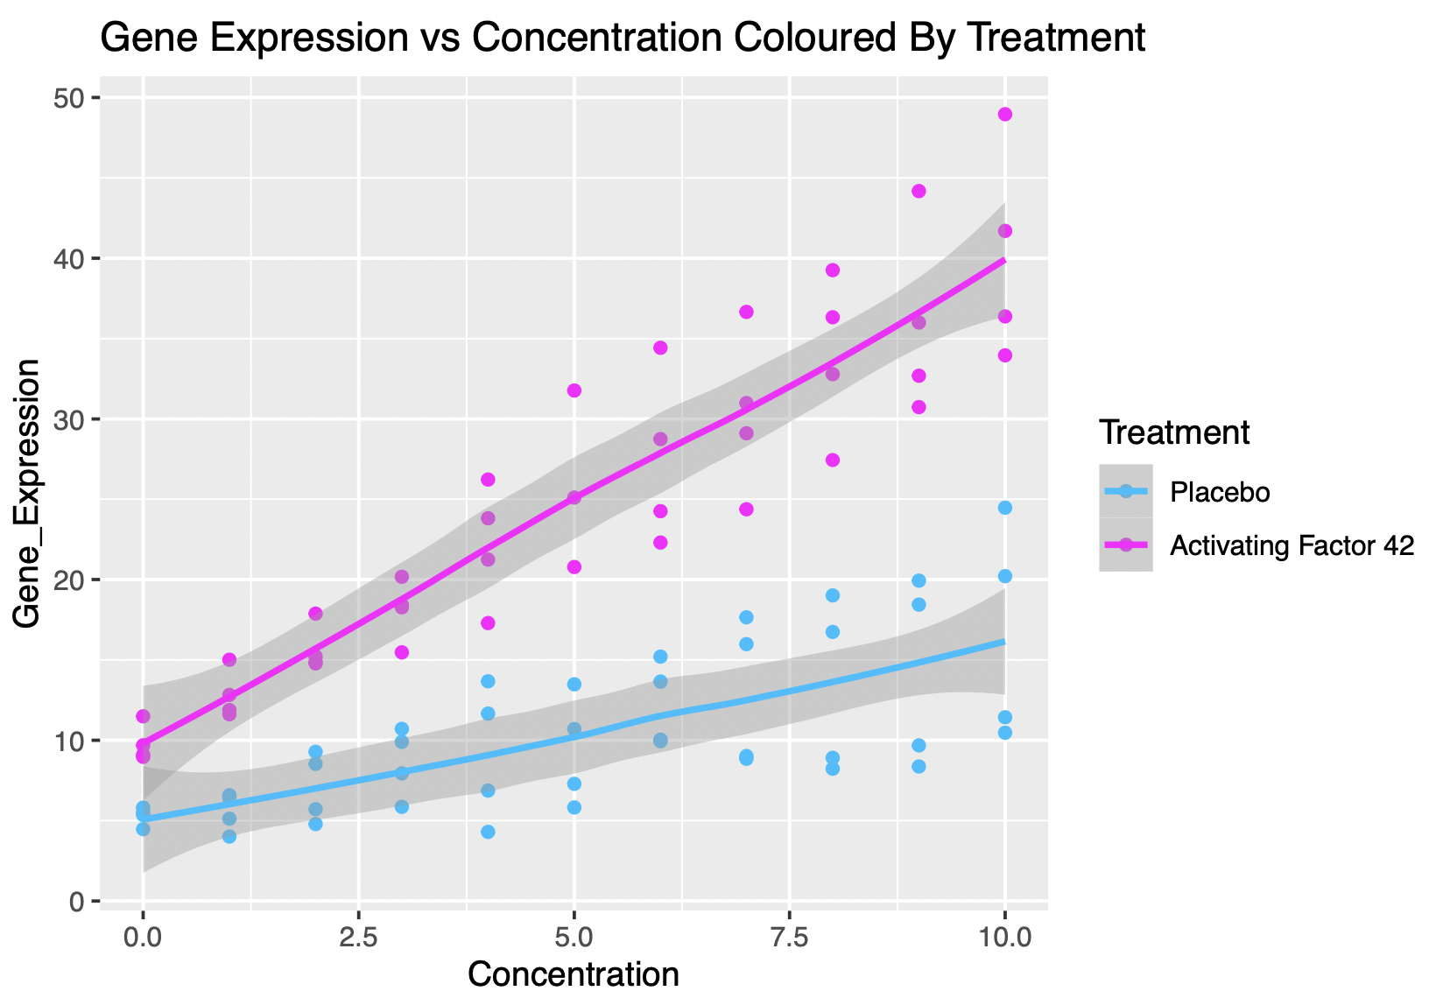
Scatterplot of Concentration vs Gene Expression {coloured by Treatment}

Slide 7
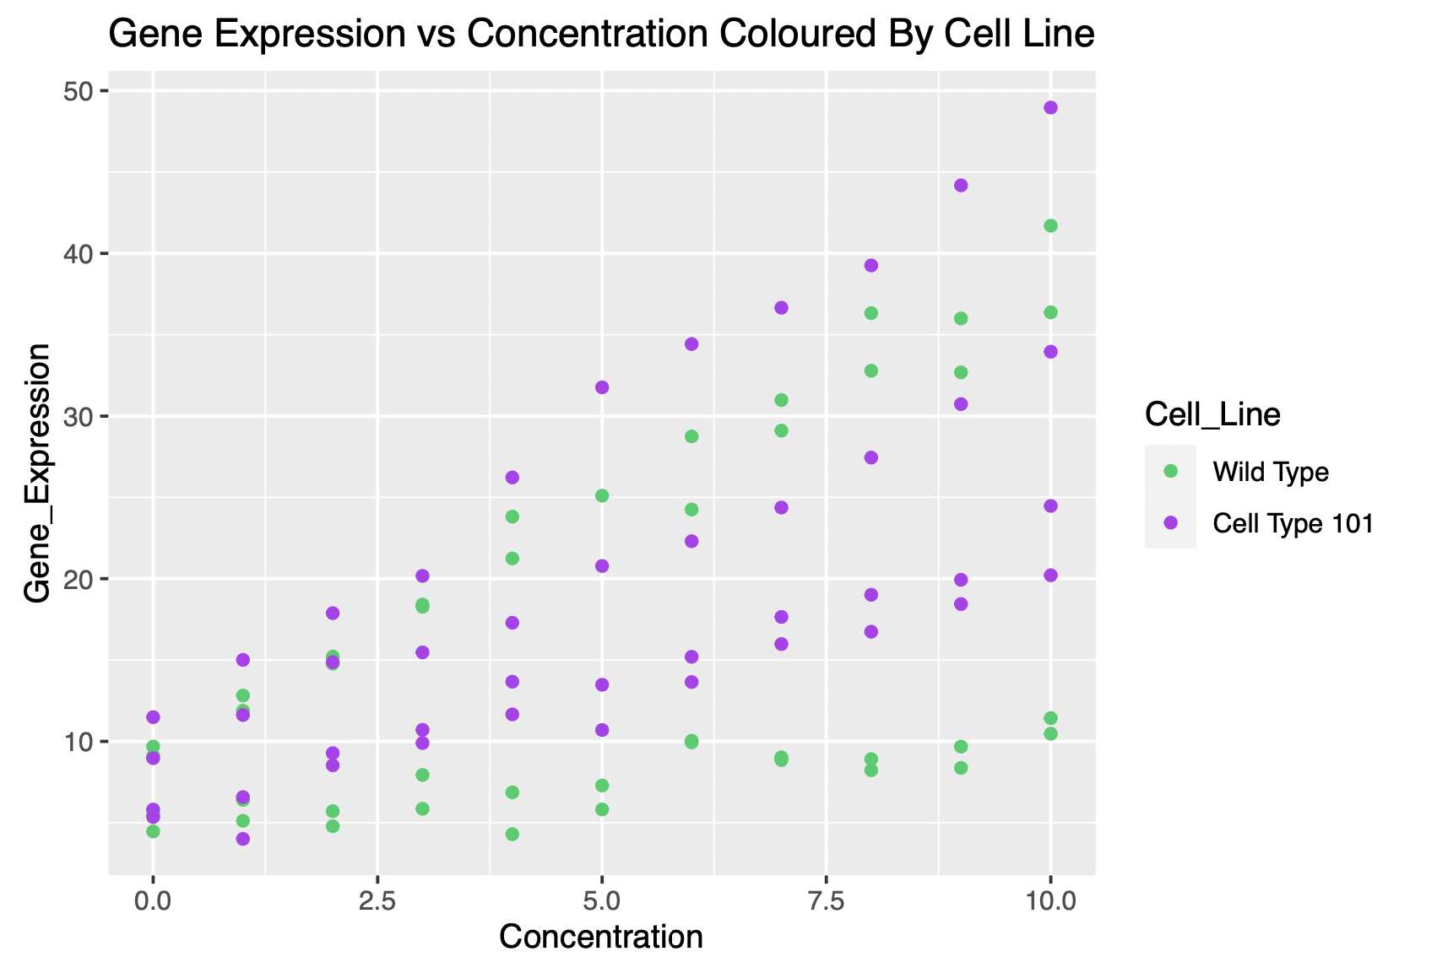
Scatterplot of Concentration vs Gene Expression {coloured by Cell line}

Slide 8
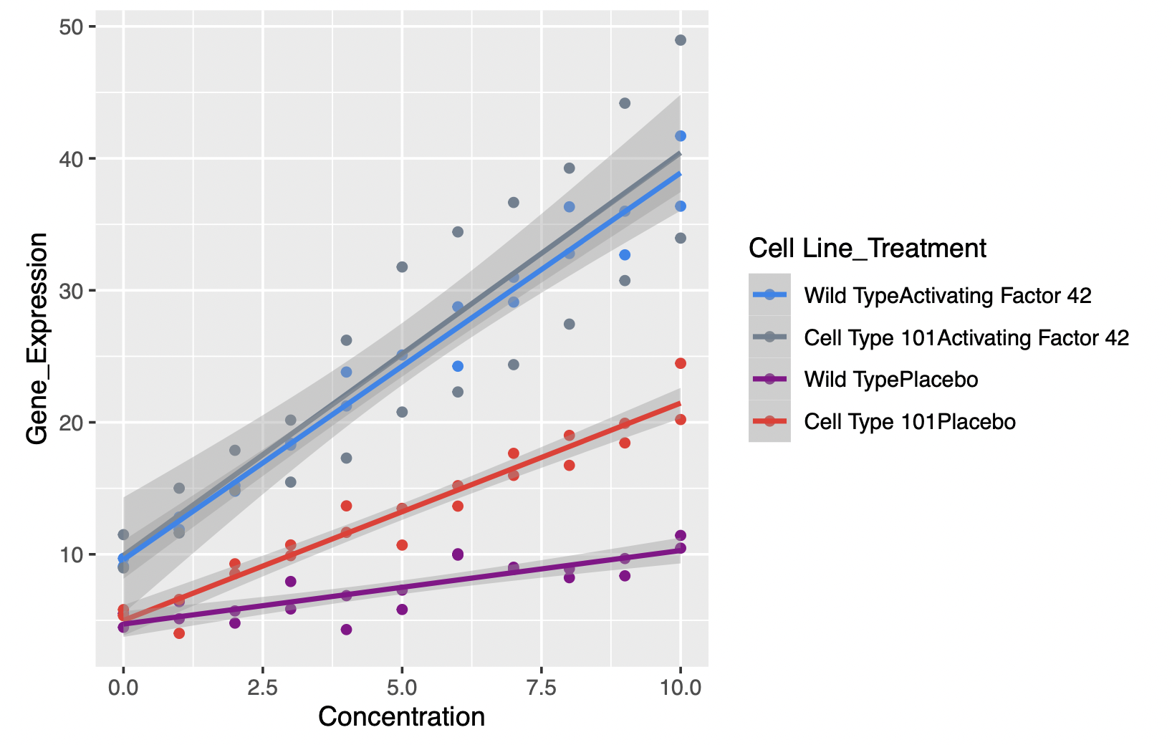
Scatterplot of Treatment Concatenated with Cell line
A point belonging to “wild typeActivating Factor 42” represents a subject who has cell line wild type and received treatment activating factor 42
Scatterplot of Treatment Concatenated With Cell Line

